Slide 1


Reporting Engine
20 Enterprise, 4th Floor, Aliso Viejo, CA 92656
www.ust-global.com

Slide 2
Reporting Engine
Overview
Report Creation Flow
Features
UI Layout
Components
Backend Architecture
Technologies Used
Charts
UST Internal

Slide 3
An Overview of Reporting Engine
Create Custom Report Template
Report Preview With Live Data
Schedule Report In Required Frequency
Get PDF/Excel Reports In Mailbox
UST Internal

Slide 4
Report Creation Flow
Create
From Blue Print
Create Custom
Drag, drop and configure Report components
Preview Report
Schedule Report

Slide 5




Features
Report Builder
Blue prints
Flexible report builder with drag and drop option, which help user to easily configure the report and give a preview of the report with live data.
Blue prints are predefines template formats.
Commonly used template format can be stored as Blue prints , so user can use this blue print to create report, without configuring report from scratch.
Report Template Selection
Create Custom report
Choose from a list of predefined Report Templates. User can also search from the list.
User can define a reports format by himself.

Slide 6

Features
Configuration
Configuration of each chart should mainly have two details, data source and date range for which the date should be taken. This configuration can be done in two methods.
Template level
Define a default data source and date range for a report template, so while configuring each chart user can use this default configuration. It will help user in configuring the report without specifying the same configuration for each chart by using this template level setting.
Components level
User can give required data source and date range for each chart specifically.

Slide 7




Features
PDF Preview/ Download
Report Scheduler
User can Preview/Download the PDF report from UI , which will be generated with the current data.
User can schedule the report to send to DLs at any frequency.
Multiple language
Adjustable chart size
PDF generation supports multiple languages English, Chinese, Japanese, Korean, ..etc..
Size of the chart can be decided by user while configuring the report

Slide 8


Features
Create Duplicate report
Report History
Create copy of an existing report, so user don’t have to configure the new report completely if it’s slightly different from an existing report.
To preview previous generated version of the report.

Slide 9









UI Layout
Template Search
Report1
Report2
Report3
Report
Schedule
Save
t
Template default
Interval
Date range
t
t
Create from Blueprint
Create Custom
Create Raw Data Report
Preview PDF
Download PDF
Duplicate report
Delete Report
Every Hour
Every Day
Every Week
Every Month
Custom
Daily
Weekly
Monthly
Quarterly
Half yearly
Yearly
Report name
Heading
Heading
Preview
Export

Slide 10

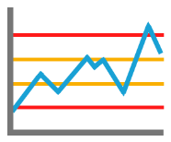
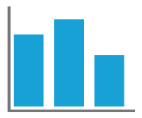
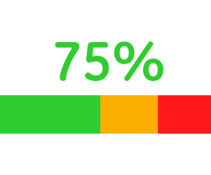
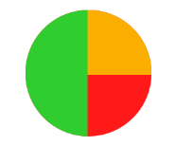
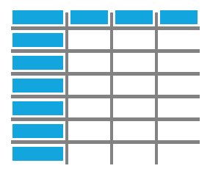







Components
Major Report Components
Custom Texts
Line Charts
Performance history of selected
Health indicator
Pie chart
Tables
Manual data table
Manual data service
Alarms
Coordinated phosphate
Variable Text
Activity feed
Value Project
Image
UST Internal

Slide 11
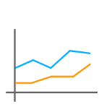
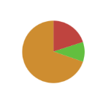
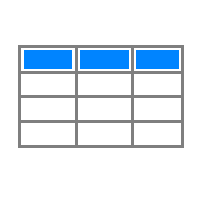

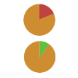
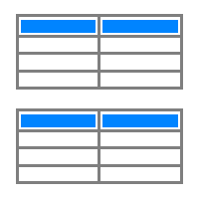
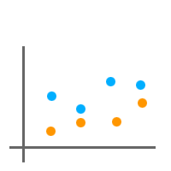
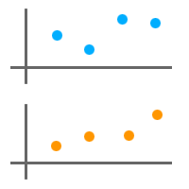
Components
Line chart
Pie chart
Tables
Single Line Chart
Single Pie Chart
Single Table
Stacked Line Chart
Stacked Pie Chart
Stacked Table
Single Scattered Chart
Stacked Scattered Chart
UST Internal

Slide 12
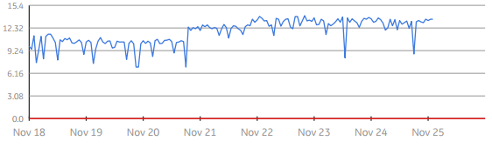
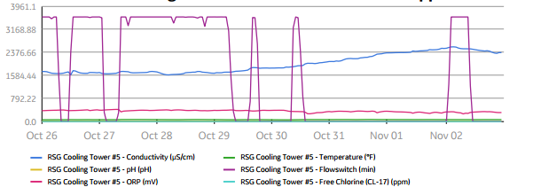
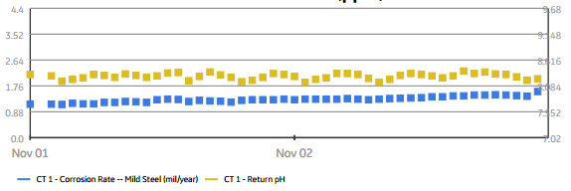
Line Chart - Examples
Single Line Chart
Multiple Line Chart
Multiple Scattered Chart

Slide 13
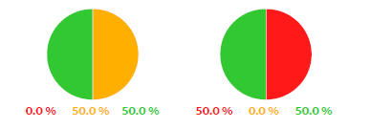
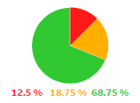
Pie Chart - Examples
Single Pie Chart
Stacked Pie Chart

Slide 14
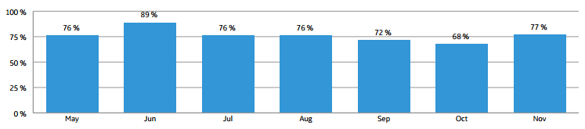
Performance History - Example
Performance History

Slide 15
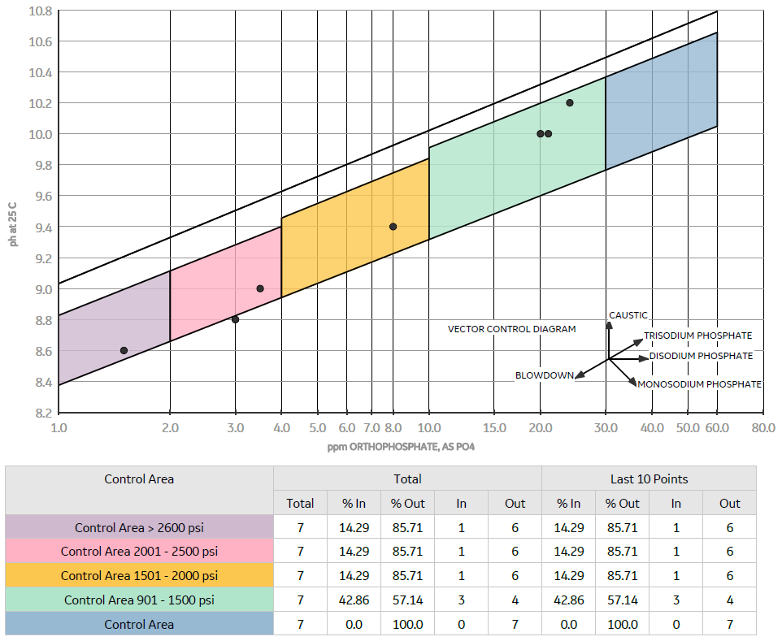
Coordinated Phosphate- Example

Slide 16
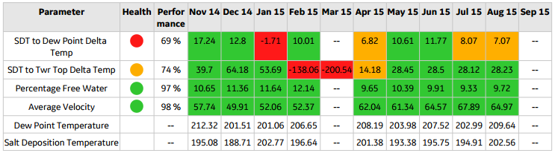
Tables- Example
Tables

Slide 17







Technologies Used
Back end
Front end

Slide 18



Backend Architecture
REPORT BUILDER
Web Server (Public)
Reporting Web Server
SCHEDULE
PREVIEW
Reports Queue (AMQ)
MetaData DB
Report Engine
Timeseries DB
Scheduled Reports Engine

Slide 19
Thank You
GE Internal

